Slide 1
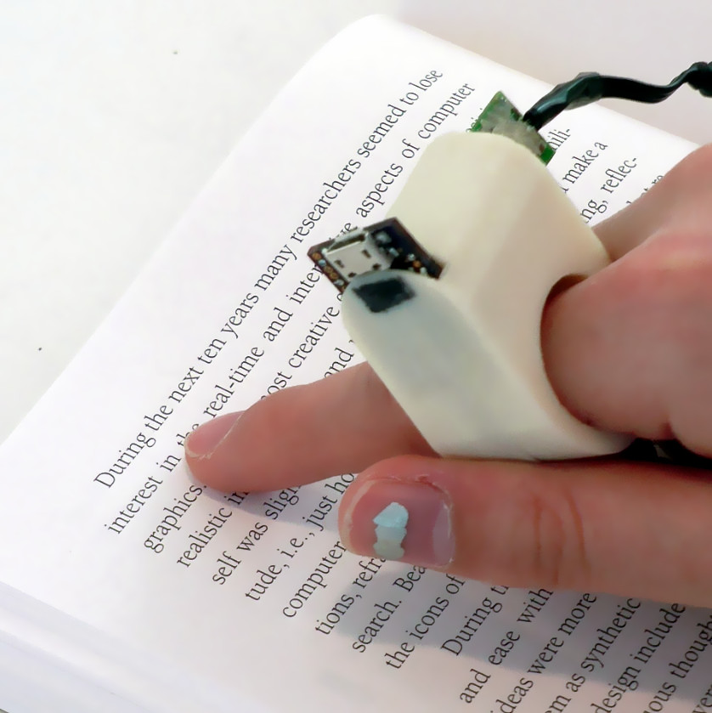
FINGER READER a WEARABLE DEVICE TO SUPPORT TEXT READING ON THE GO
PRESENTED BY
MADIRAJU GAYATHRI BHAVANI
20JJ5A1206

Slide 2
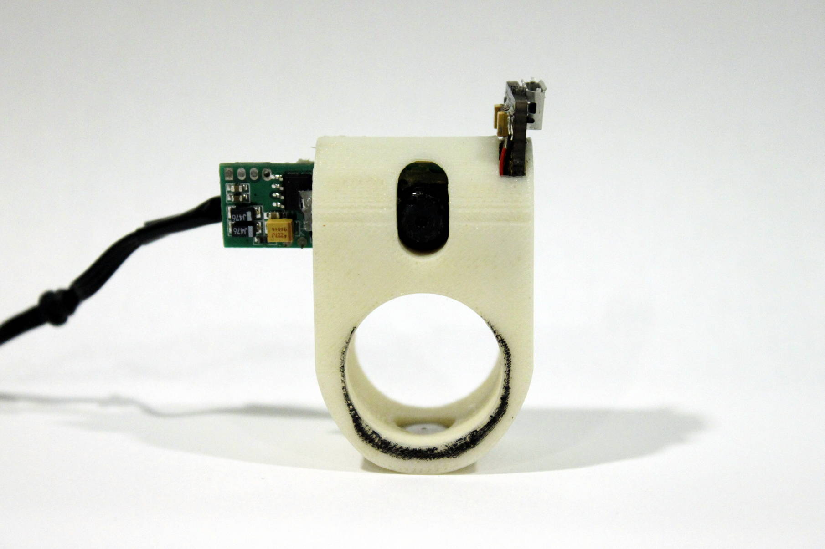
CONTENTS
Abstract
Introduction
Need Of Finger Readear
Technologies Used:
- Hardware Used
- Software Used
Working
Advantages
Disadvantages
Conclusion
Reference

Slide 3
abstract
visually impaired people report numerous difficulties with accessing printed text using existing technology , including problems with alignment , focus, accuracy , mobility and efficiency.
We present a finger worn device that assists the visually impaired with effectively and efficiently reading paper – printed text.

Slide 4
INTroduction
Braille is the standard tactile reading tool used by the blind for printed text , and the system is credited for boosting literacy levels among the visually impaired. However, many books are still not available in braille.
Dr. Pattie Maes , founder and director of MIT Media Lab’s Fluid Interfaces research group, who developed Finger Reader.
The Finger Reader is a 3D printed ring-like device worn on the index finger.
It has a small camera on top which scans printed text and monitors finger movements.

Slide 5
Need OF Finger Reader
The product attempts to offer blind people the possibility of reading a book like anyone with a normal vision would.
In addition , it also serve as an aid for language translation.

Slide 6
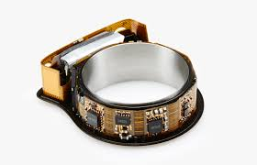
Technologies used
Hardware Details :
The Finger Reader hardware was designed using:
Multimodal feedback via vibration.
A new dual – material case design.
A high – resolution mini video camera.

Slide 7
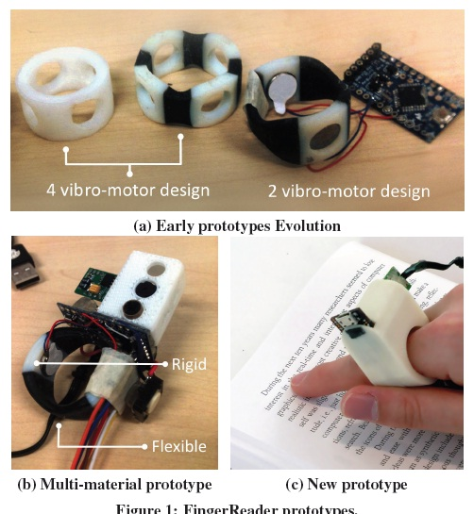

Slide 8
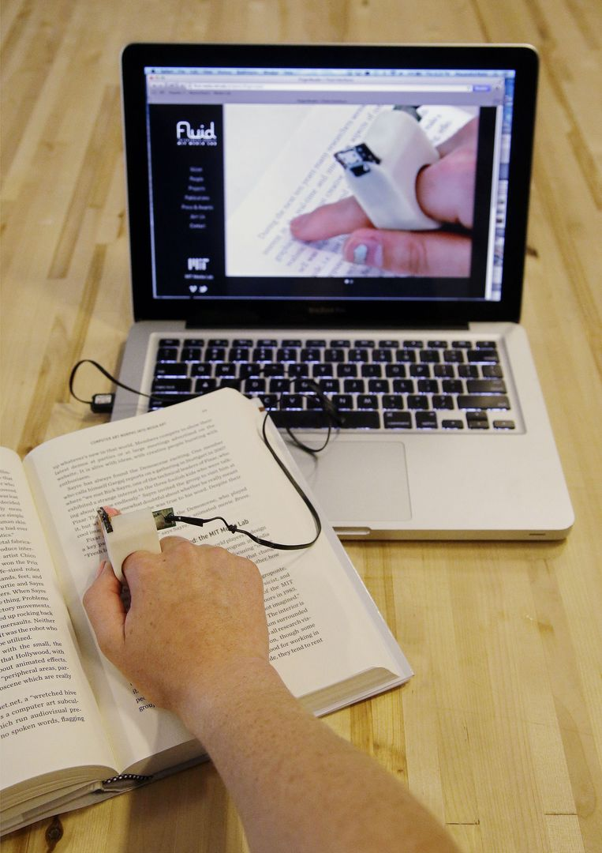
Software Details :
To accompany the hardware , a software stack that includes.
A text extraction algorithm.
Hardware control driver.
Integration layer with tesseract OCR.
Flite Text-to-speech (TTS)

Slide 9
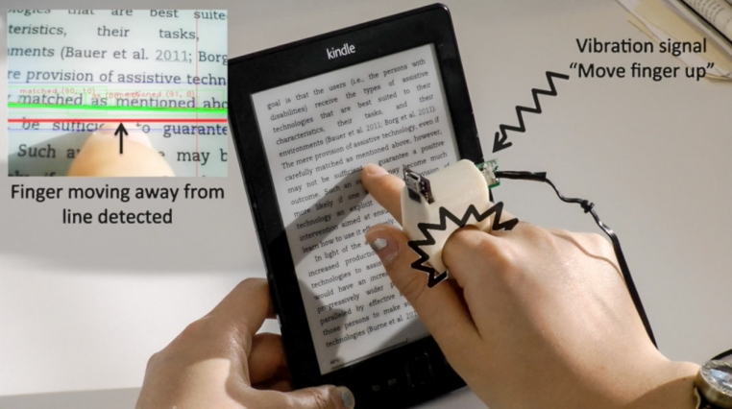
working
If the user veers away from a text line, tactile feedback is provided by two vibration motors embedded in the 3D printed case.
Auditory cues alert the user at the beginning and the end of reading passages.

Slide 10
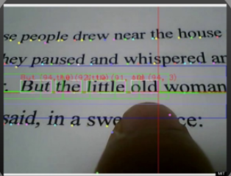
A novel-tracking based algorithm extracts text locally and sequentially, rather than in whole text blocks and pages like many existing device use.

Slide 11
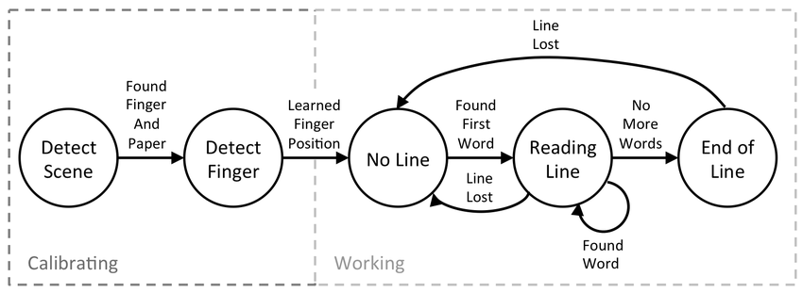

Slide 12
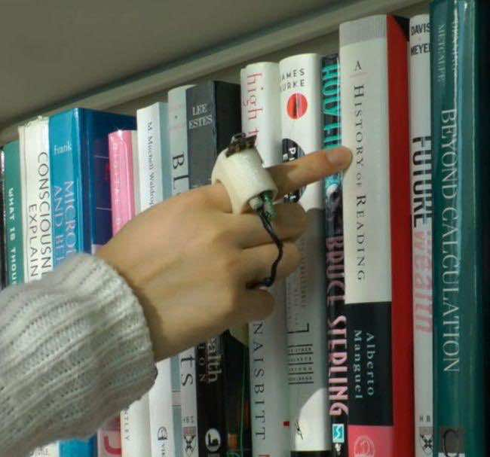
Advantages
The Finger Reader wearable health device can help them gain access to a greater number of learning resources and contribute greatly to their quality of life.
The index – finger worn fevice is “ a lot more flexible, a lot more immediate than any solution that have right now.

Slide 13
conclusion
Finger Reader presents a new way for VI people to read printed text locally and sequentially rather than in blocks like existing technologies dictate.
The design is motivated by a user needs study that shows the benefit in using continuous multimodal feedback for text scanning, which again shows in a qualitative analysis we performed.

Slide 14
References
http://www.seminarsonly.com/ finger-reader-seminar-report- ppt.php
http://fluid.media.mit.edu/ projects/fingerreader
ABiSee. EyePal ROL, 2013.http://www.abisee.com/products/eye-pal-rol.html
Blindsight. Text detective, 2013. http://blindsight.com/textdetective/
Smith, R. An overview of the tesseract OCR engine. In ICDAR (2007), 629– 633.

Slide 15


